Slide 1
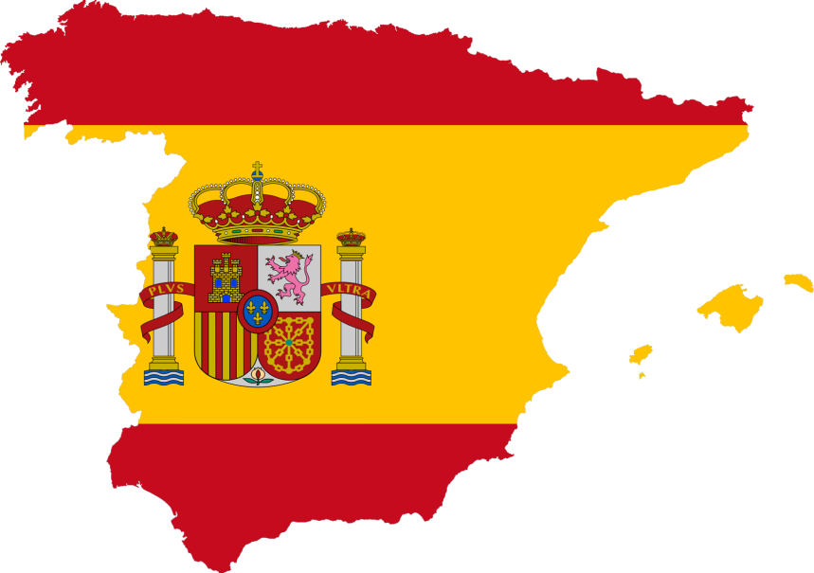
Architecture influenced by Mathematics
SPAIN

Slide 2
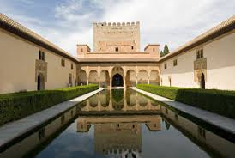
THE ALHAMBRA PALACE, GRANADA , SPAIN
The palace was built by the Nasrid dynasty. There are three palaces, the Comares Palace, the Palace of Lions and the Partal Palace.
Symmetry is found not only in the architecture, but also in the patterns of the stucco (fine plaster used for coating wall surfaces) and tile work.

Slide 3
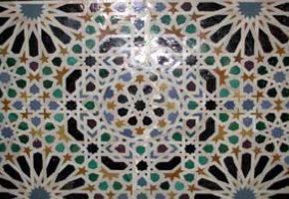
Radial patterns
Tiling patterns of certain tiles are radial, which start at a central point and have rotations about the central point or reflections through the central point. The total number of symmetries will be finite. The symmetry groups that contain only rotations are called cyclic and those that contain reflections are called dihedral.

Slide 4
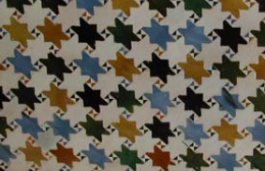
Periodic patterns
The second type of pattern involves translational symmetries in two independent directions. These patterns are classified by the smallest angle of rotation that appears in the pattern. By a property known as crystallographic restriction, the
angles that appear in rotations for the patterns are 60°, 90°, 120°, 180°.

Slide 5
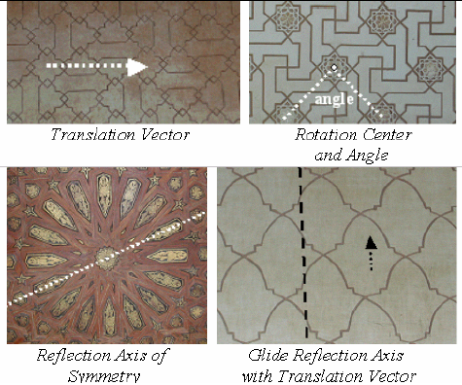
Other types of symmetry

Slide 6
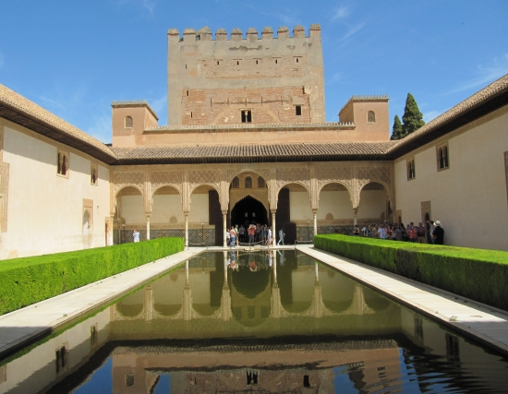
The pool of water in front of the patio gives the idea of a horizontal reflection. It makes the object appear to have the symmetries of a dihedral finite figure of order 2 instead of order 1 (bilateral symmetry).

Slide 7
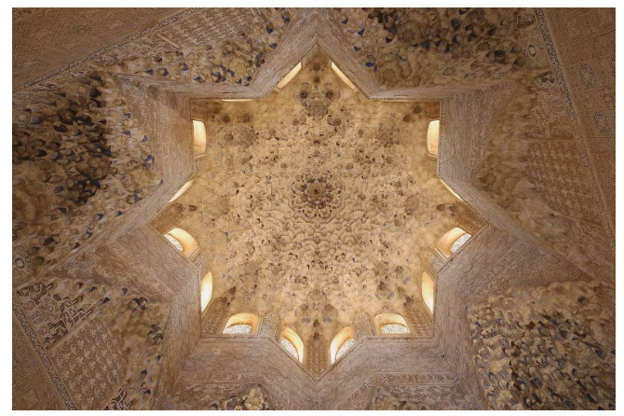
There is a round dome on top of a square structure, with an eight pointed decorative star indenting the circle, which is similar to the use of pendentives.

Slide 8
BASILICA I TEMPLE EXPIATORI DE LA SAGRADA FAMILIA

Slide 9
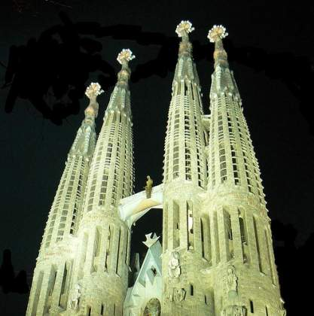
BASILICA I TEMPLE EXPIATORI DE LA SAGRADA FAMILIA, SPAIN
The Basílica i Temple Expiatori de la Sagrada Família is a large unfinished Roman Catholic church in Barcelona, designed by Catalan architect Antoni Gaudí.

Slide 10
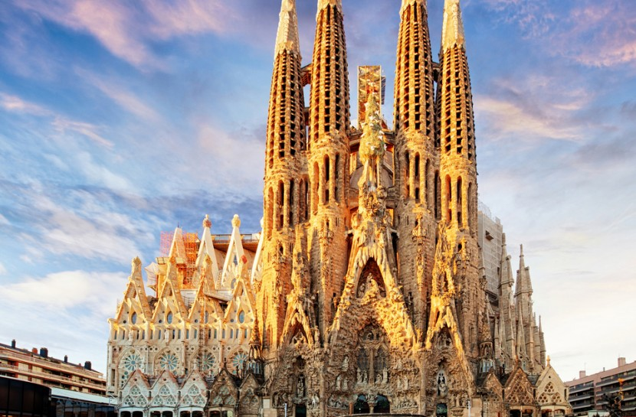
Gaudi used hyperbolic paraboliod structures (a quadric surface, in this case a saddle-shaped doubly-ruled surface, that can be represented by the equation z = x²/a² – y²/b²), which can be seen within particular façades.

Slide 11
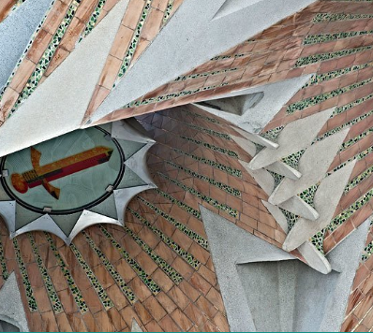
Hyperboloids : They can be solid as in the junctions between the columns and the vaulting, or hollow, to allow light to enter the temple. They can be found in the openings of the windows and the vaults.

Slide 12
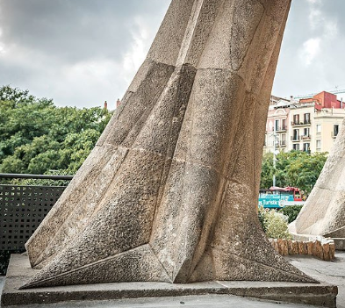
Paraboloids : Gaudí used paraboloids to create linking surfaces between the vaults and the roofing and the columns on the Passion facade, as well as larger elements such as the towers and the sacristies.

Slide 13
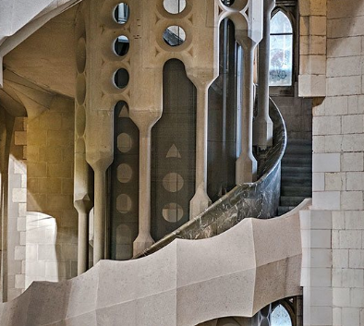
Helicoids : According to the iconography of Gaudí they represent the rising movement that links the earth with heaven. Here they can be seen in the spiral staircases.

Slide 14
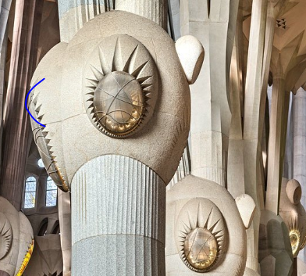
Ellipsoids : Gaudí generated the rounded capitals of the main columns from ellipsoids, where the columns subdivide into branches.

Slide 15
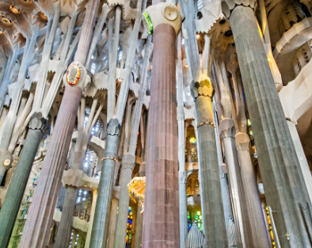
Double-twisted columns : To achieve greater stability and a slender and more harmonious effect, Gaudí designed all the branching columns as double-twisted columns formed by two helicoidal columns. The base of each column has a cross-section that is a polygon or star which as it twists to the right and the left transforms into a circle higher up

Slide 16
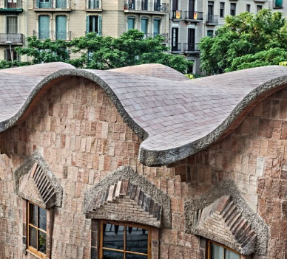
The best examples of conoids at the Sagrada Familia are the walls and roofs of the schools building.

Slide 17
Thank you

