Slide 1
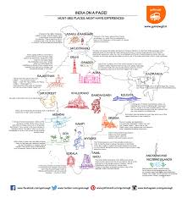

ARCHITECTURE INSPIRED BY MATHEMATICS
SADHBHAVANA WORLD SCHOOL

Slide 2
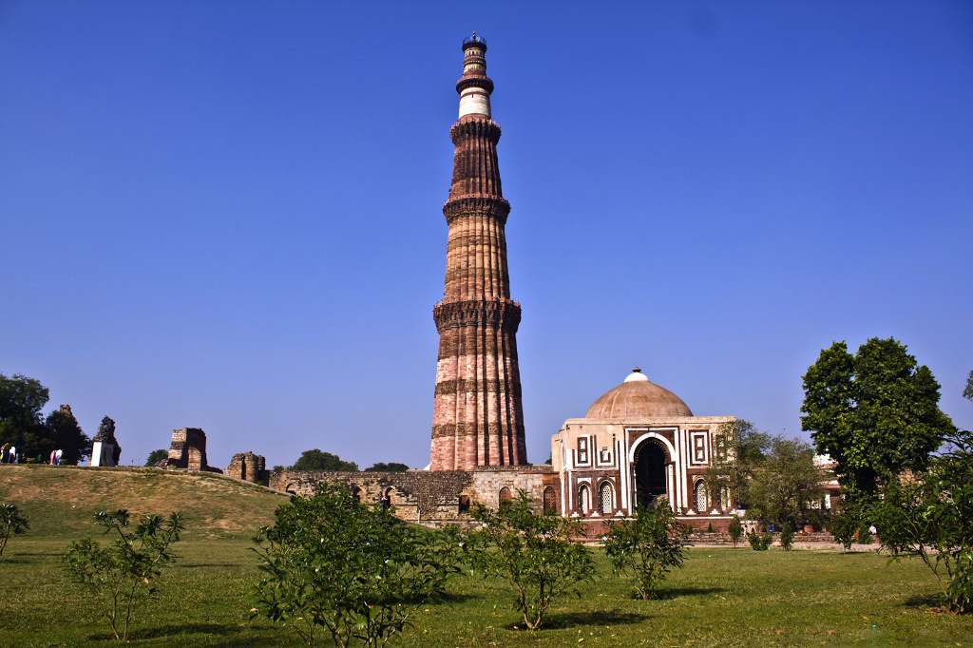
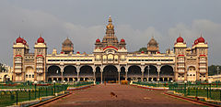
INDIAN MONUMENTS
1. QUTUB MINAR
2. MYSORE PALACE
I am the Qutub Minar
I am the Mysore Palace

Slide 3
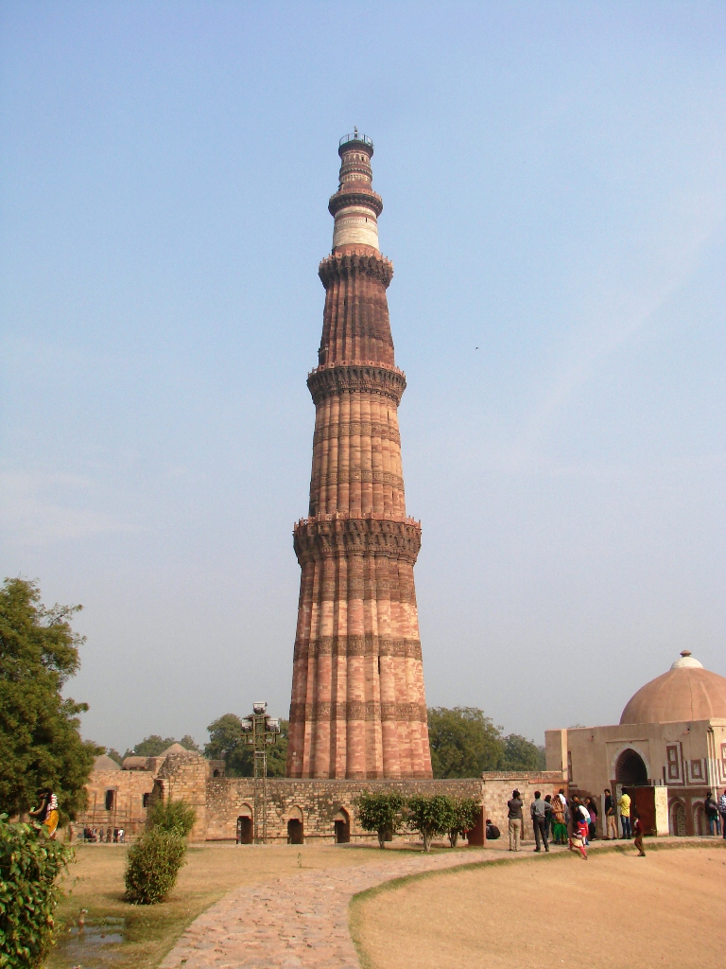
QUTUB MINAR
The Qutub Minar, also spelled as Qutab Minar, or Qutb Minar, is the tallest minaret in the world made up of bricks.
The minaret forms a part of the Qutab complex, in the Mehrauli area of Delhi. It is a part of UNESCO World Heritage

Slide 4
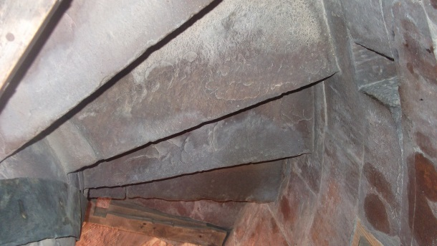
DIMENTIONS OF QUTUB MINAR
Qutub Minar is a 73-metre (239.5 feet) tall tapering tower of five storeys , with a 14.3 metres (47 feet) base diameter, reducing to 2.7 metres (9 feet) at the top of the peak. It contains a spiral staircase of 379 steps.
Its design is thought to have been based on the Minaret of Jam , in Western Afganistan

Slide 5
THE HISTORY
Qutab-Ud-Din-Aibak, founder of the Delhi Sultanate , started construction of the Qutub Minar's first storey around 1192.
In 1220, Aibak's successor and son-in-law Shamsuddin Iltutmish completed a further three storeys.
In 1369, a lightning strike destroyed the top storey .Firoz Shah Tughlaq replaced the damaged storey, and added one more. Sher Shah Suri also added an entrance to this tower while he was ruling and Humayun was in exile.
It took many years to complete the monument.

Slide 6
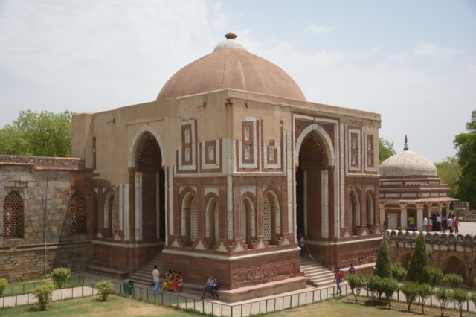
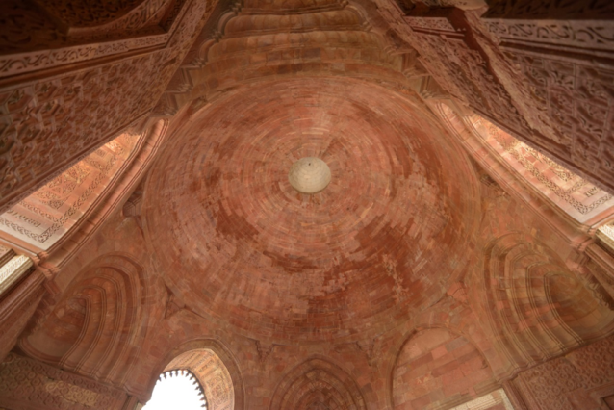
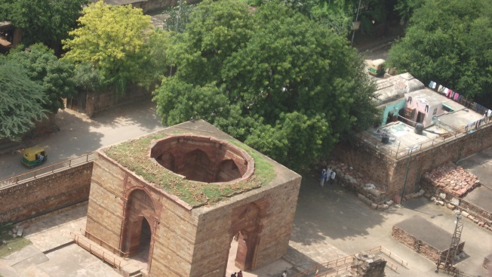
NEIGHBOURHOOD
The Minar is surrounded by several historically significant monuments of the Qutab complex, including Quwat-ul-Islam Mosque, which was built at the same time as the Minar, and the much older Iron Pillar of Delhi.

Slide 7
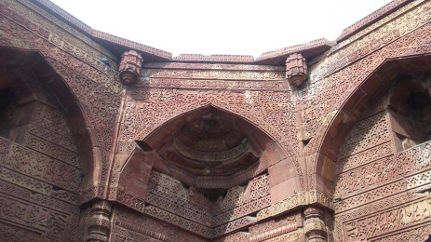
MATHEMATICAL PATTERN OF QUTUB MINAR
Qutub Minar is not spherical at the bottom. Instead, it's base octagonal in shape similar to the Minar of Jam in Afghanistan. This is made on purpose in order to develop strength in such a tall structure for it's time. Without this shape, it would have been very difficult to keep such a structure, still, with medieval technology and materials. It should also be noted that Qutub Minar was not made by one person at one time and instead, the whole structure was construed in stories over a number of royal families and generations.
Qutab Minar has only one line of symmetry which is vertical.

Slide 8
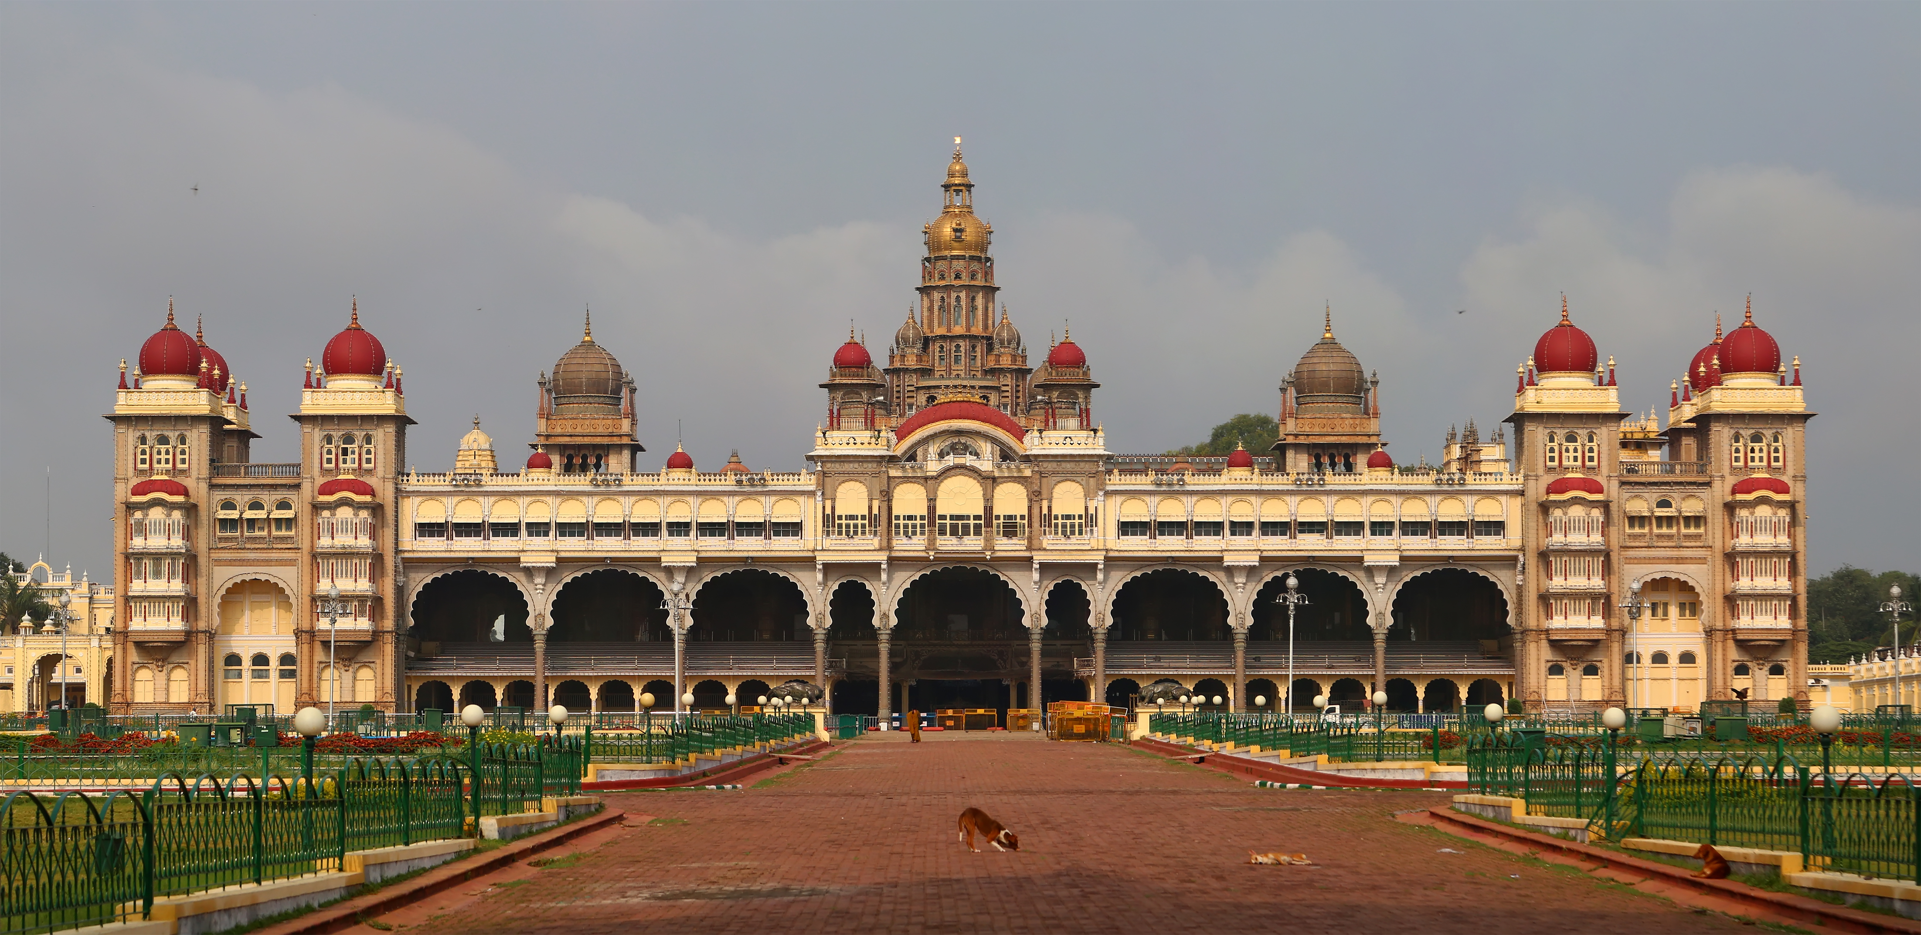
MYSORE PALACE

Slide 9
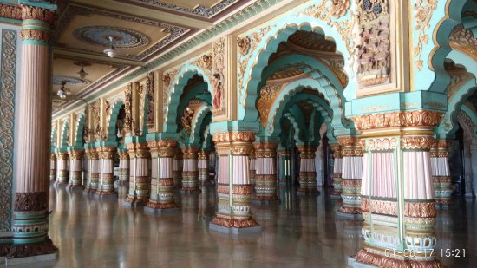
HISTORY
AmbavilasPalace otherwise called The Mysore Palace is a historical and Royal residence, situated in the city of Mysuru in Karnataka.
Lord Henry Irwin was the Architect who was appointed by the then Mysore Maharaja Krishnaraja Wodeyar IV and his mother Maharani Kempananjammanni Devi. The Palace was completed in the year 1912.
The Architecture style of this palace is a blend of Hindu, Mughal, Rajput and Gothic styles.

Slide 10
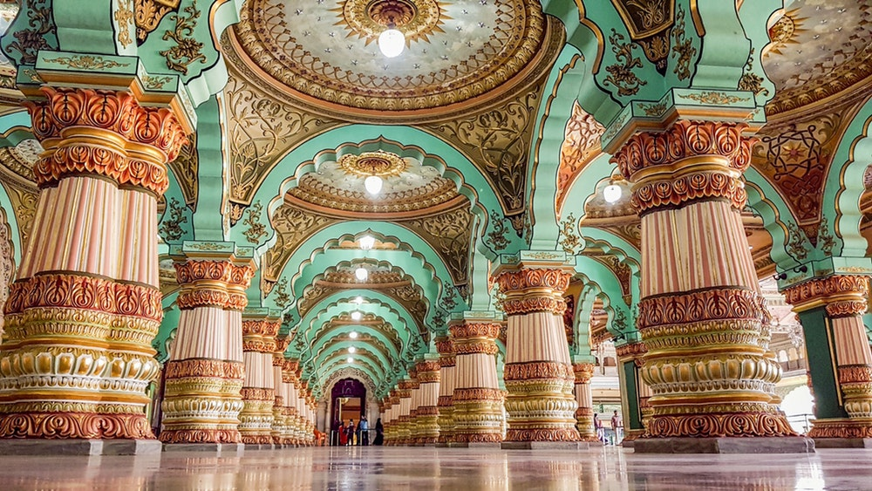
Mathematical tessellation
The photo is that of a room in the palace where the King used it as a hall for private audiences. It was the chamber in which he gave audience to people deserving special attention.
The central part of the hall has ornately gilded columns, stained glass ceilings, decorative steel grills, and chandeliers with fine floral motifs, mirrored in the pietra dura mosaic floor embellished with semi-precious stones. Its Tessellations are very colourful.

Slide 11
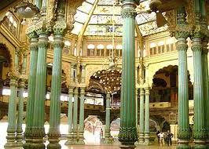
DETAILS
Construction of the palace started in 1897 and got completed in1912.
The octagon-shaped Kalyana Mantapa, where royal weddings and functions were organised, is another important section of the palace.
The most prominent feature of this hall is the set of 26 paintings that depict the Dasara procession.

Slide 12
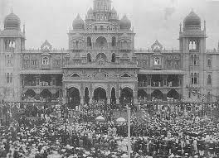
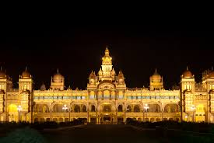
FESTIVALS IN MYSORE
The most interesting time to be in Mysore is for the Dussera celebration in October. The city and the palace are resplendent with lights and festivities.
During these days, the structure is illuminated using 97,000 electric bulbs. People from all across the globe come here to behold this spectacular sight.

Slide 13
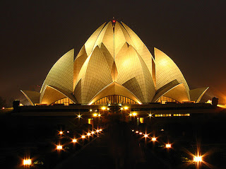
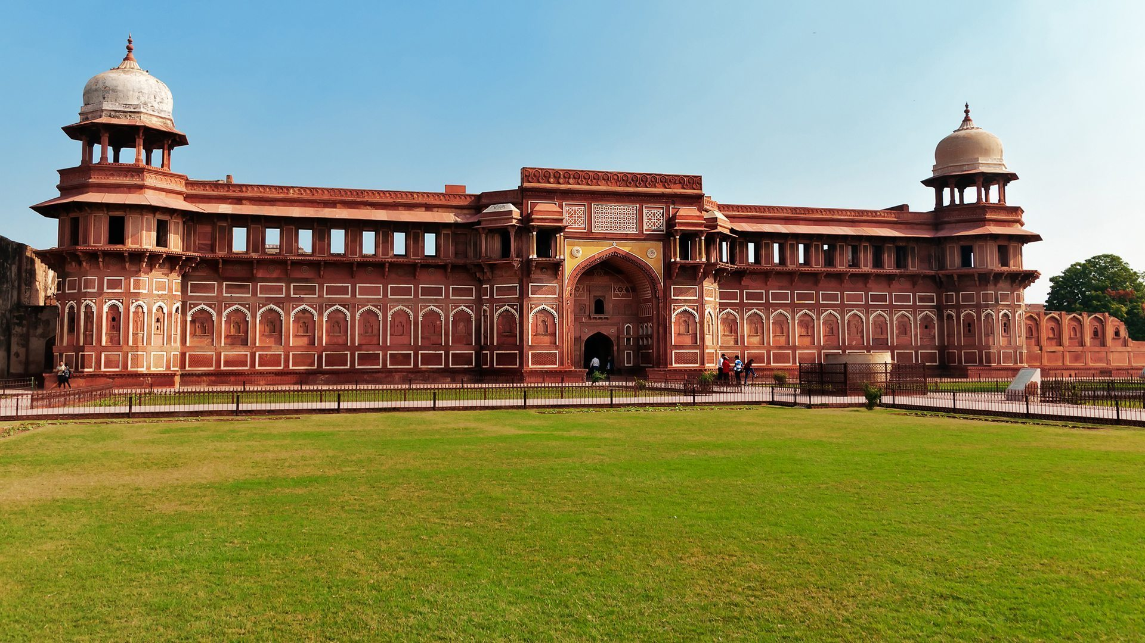
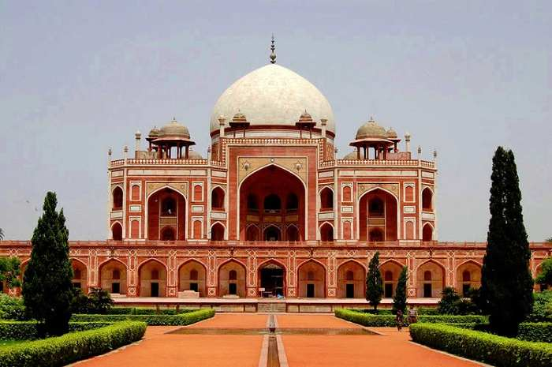
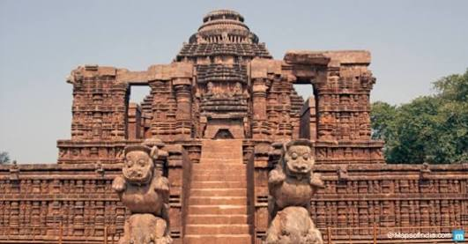
I am the lotus temple
I am the Agra Fort
SOME OTHER MONUMENTS IN INDIA WITH SYMMETRY
I am Humayun’s Tomb
I am the Konark Temple

Slide 14
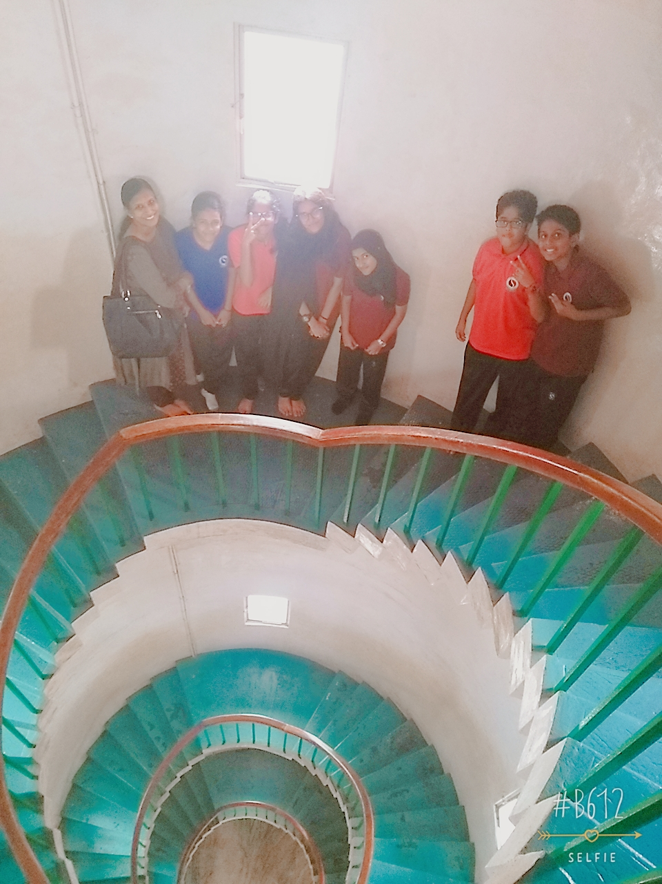
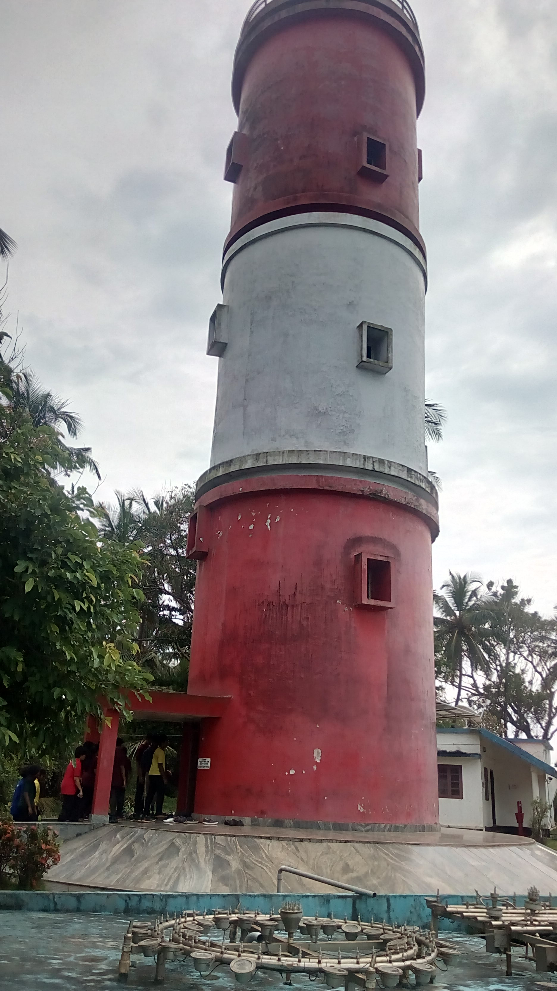
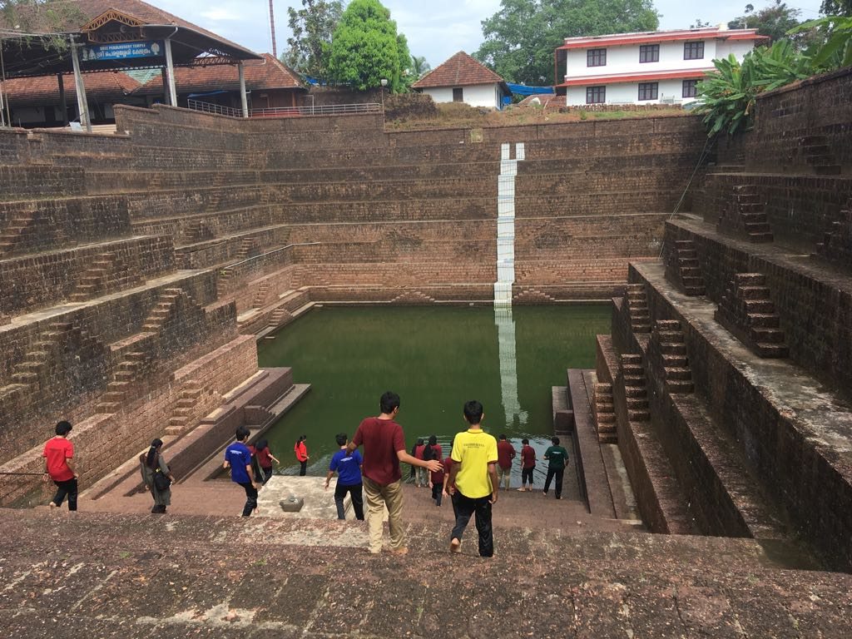
FIELD TRIP INDIA
I am the winding staircase
I am the Light House
I am the perallasery temple pond

Slide 15
THANK YOU

